Slide 1
Windows Server 2022

Slide 2
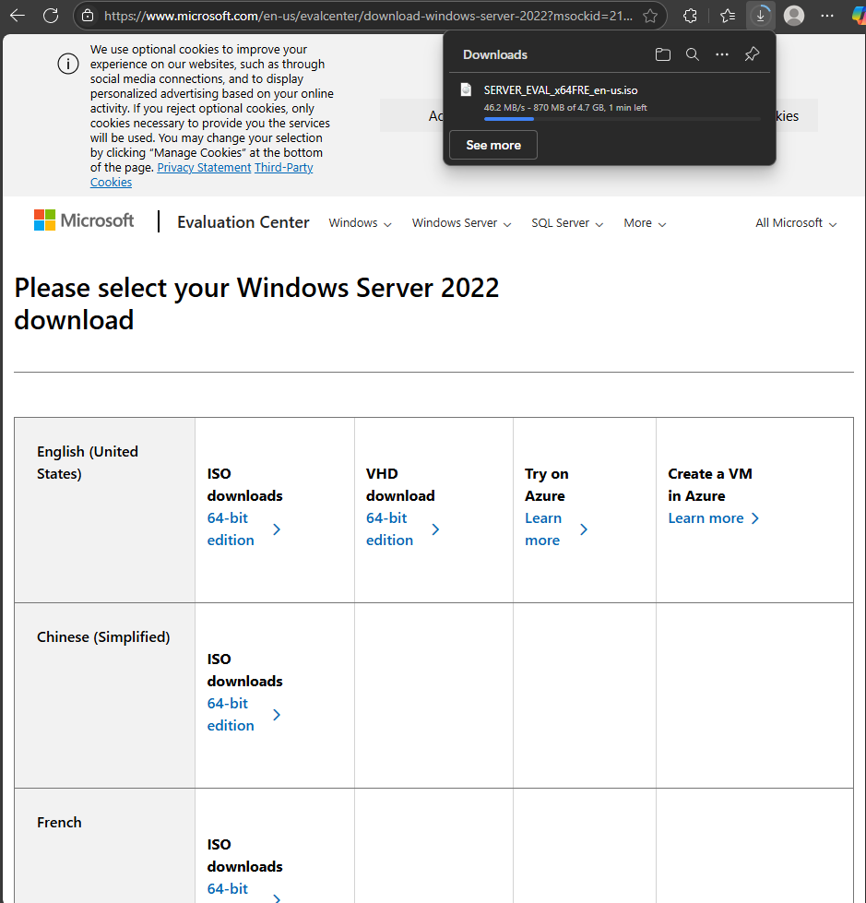
Get iso download

Slide 3
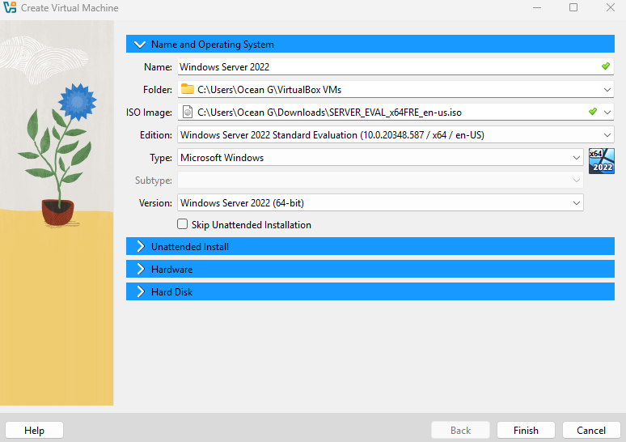

Slide 4
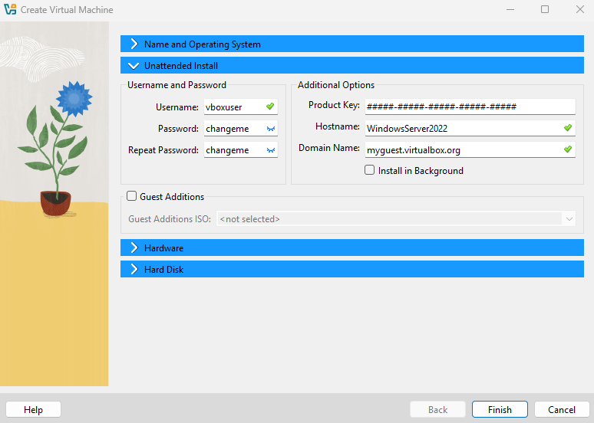

Slide 5
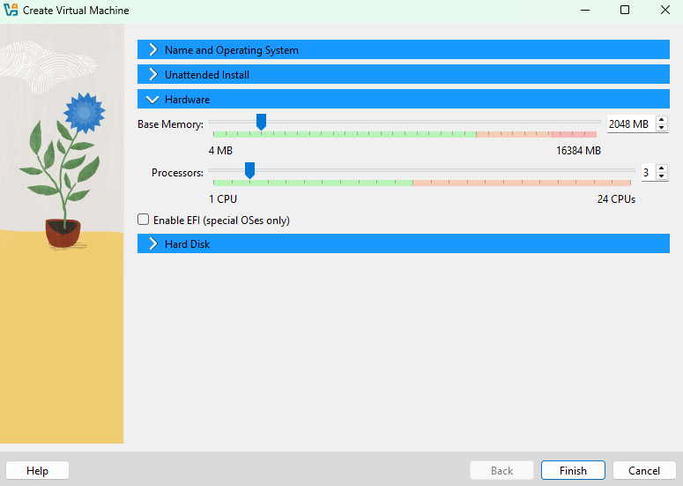
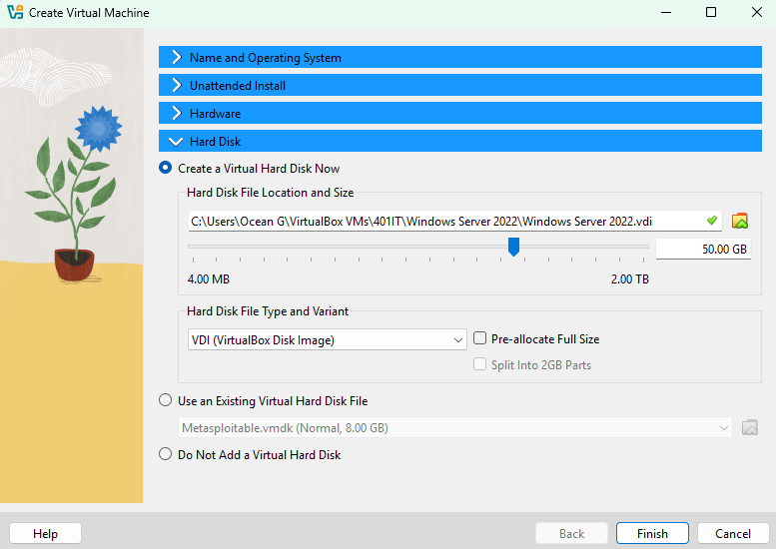

Slide 6
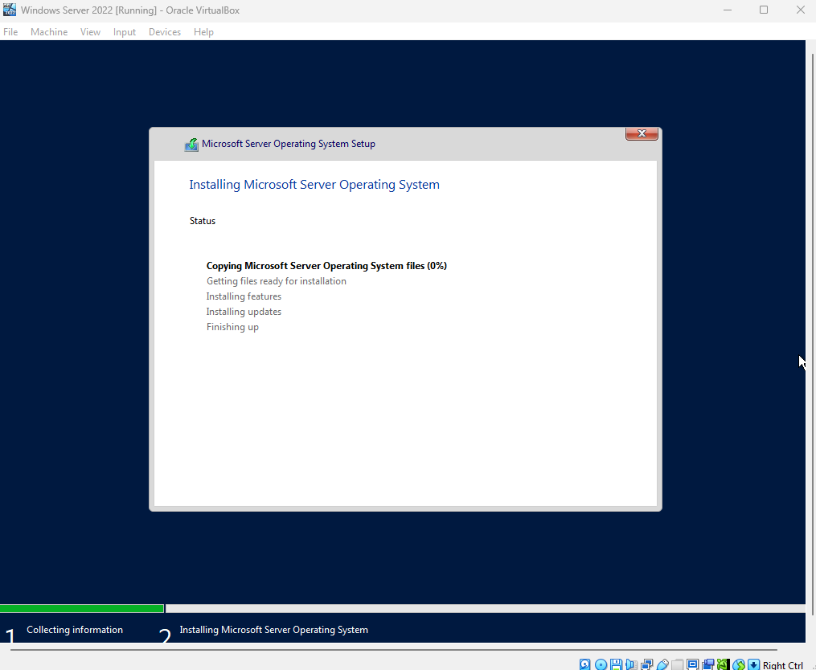

Slide 7
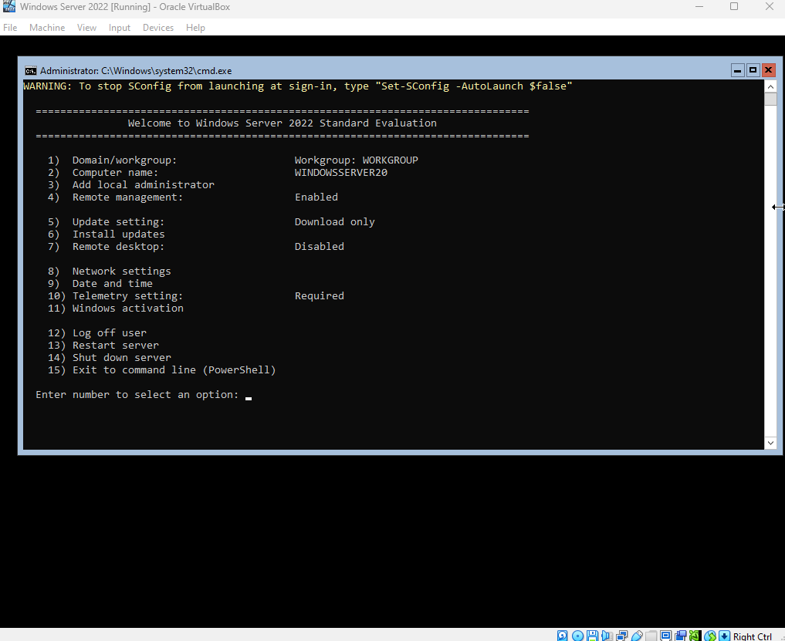
Successful installation
Second version of was installed that had a gui

Slide 8
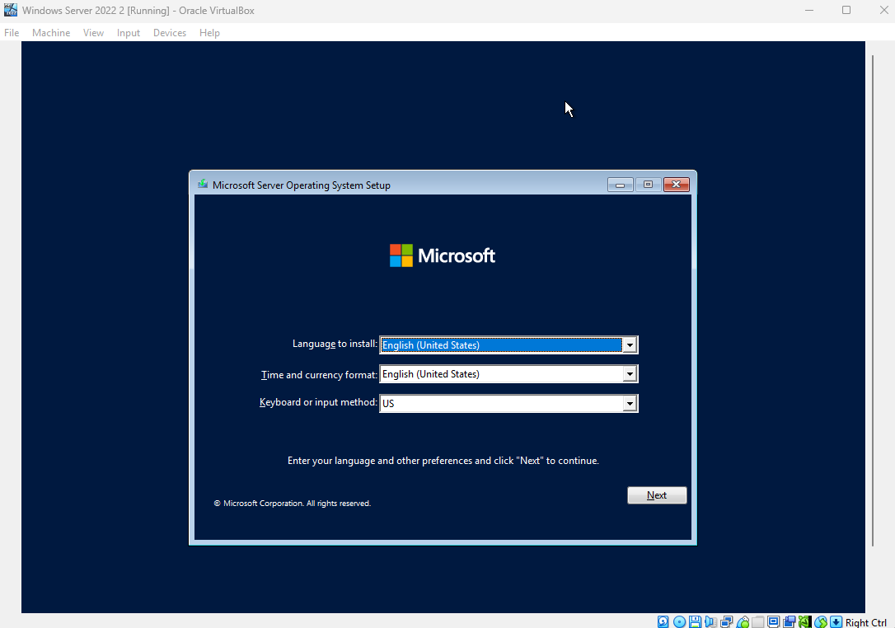

Slide 9
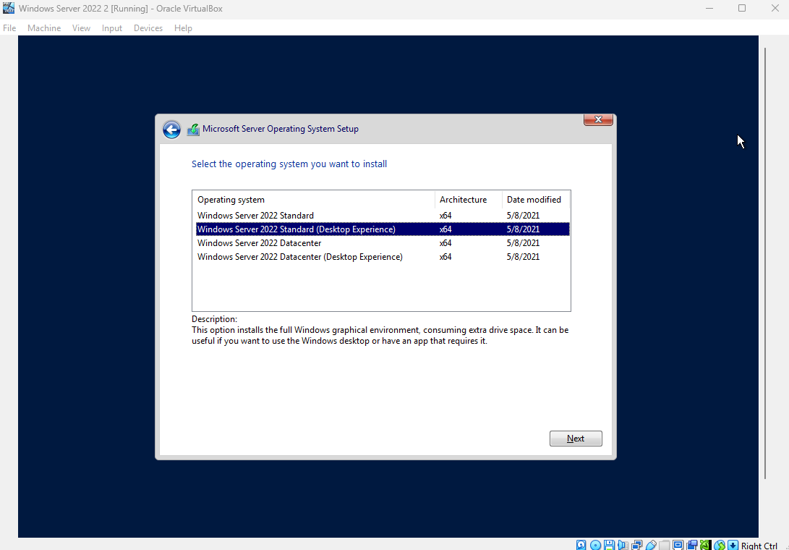

Slide 10
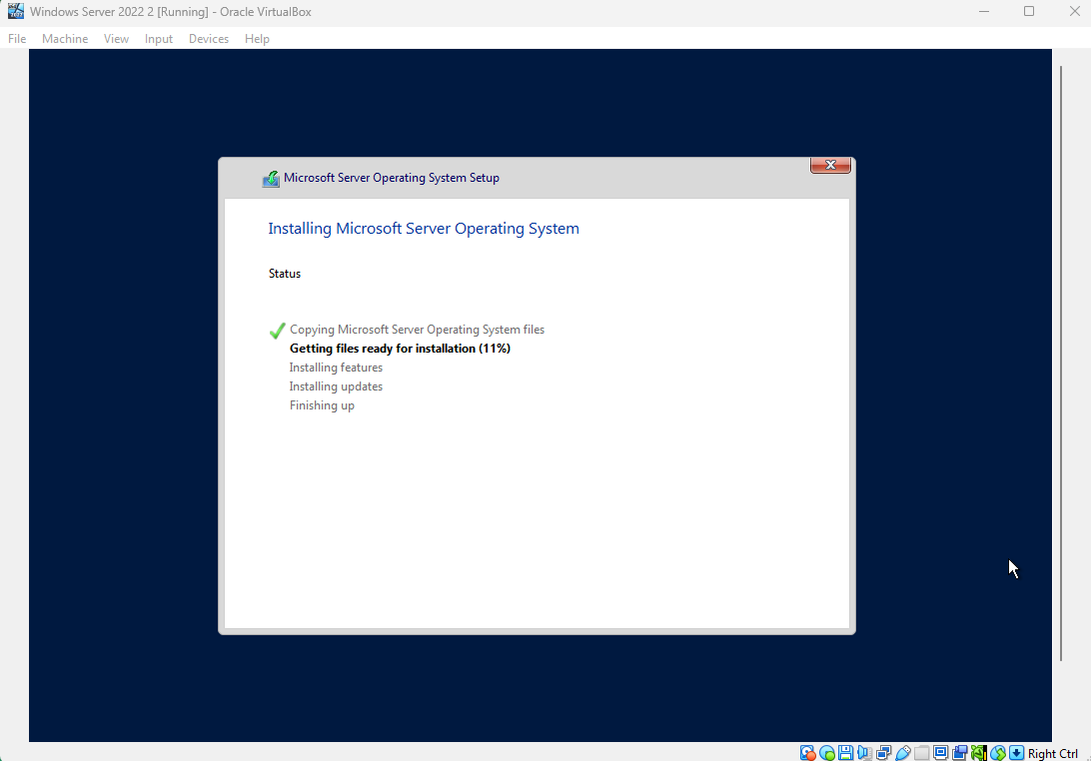

Slide 11
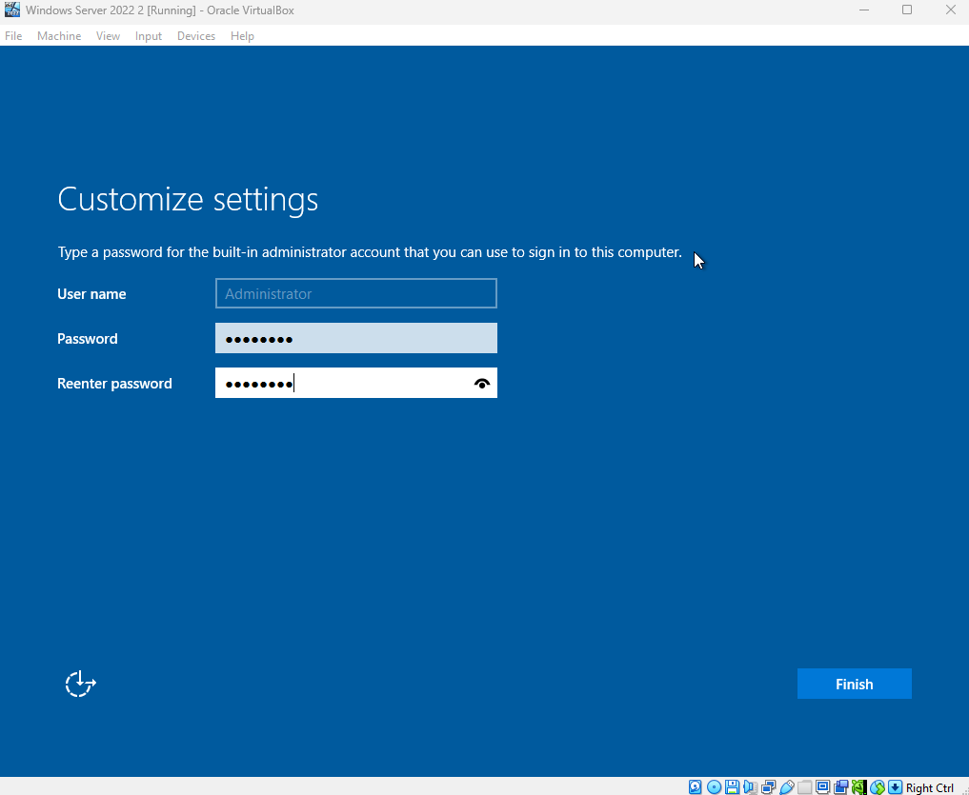
Password
changeme!12
changeme!12

Slide 12
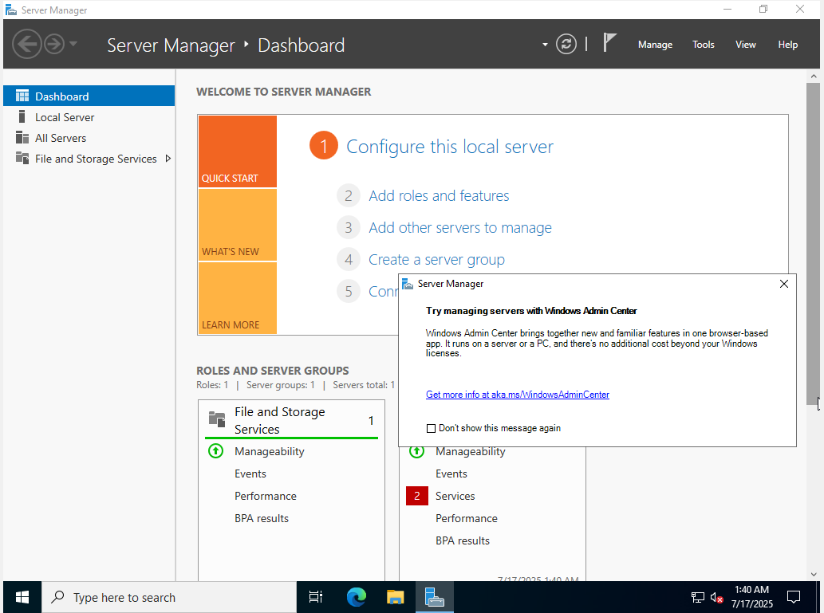

Slide 13
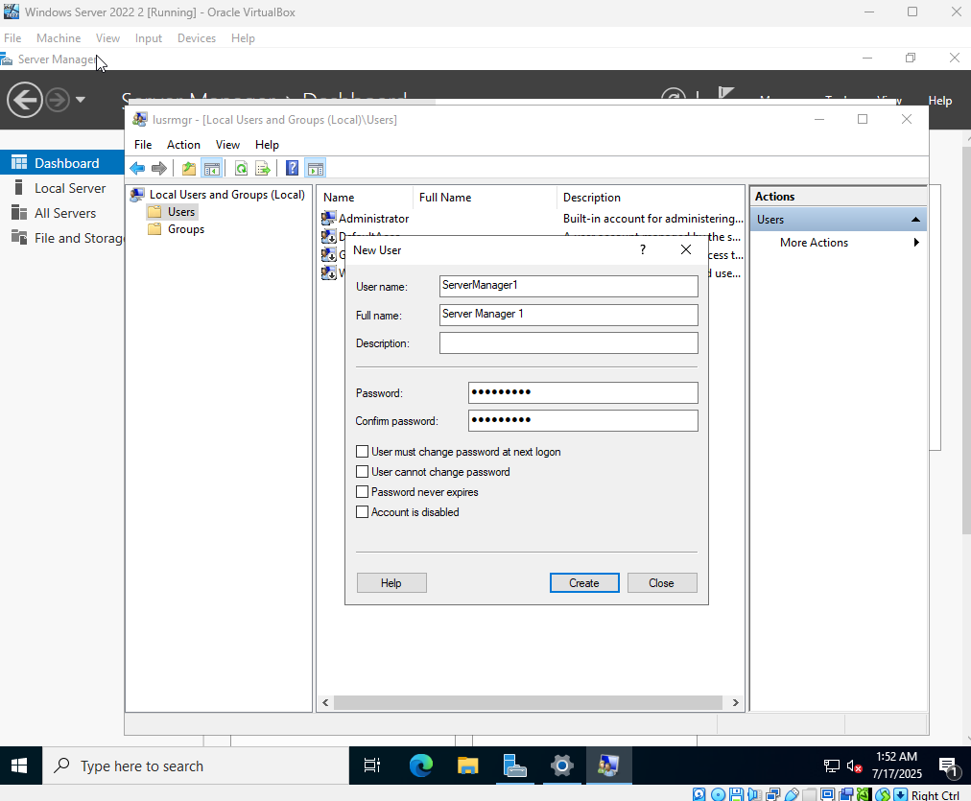
GUI User Account

Slide 14
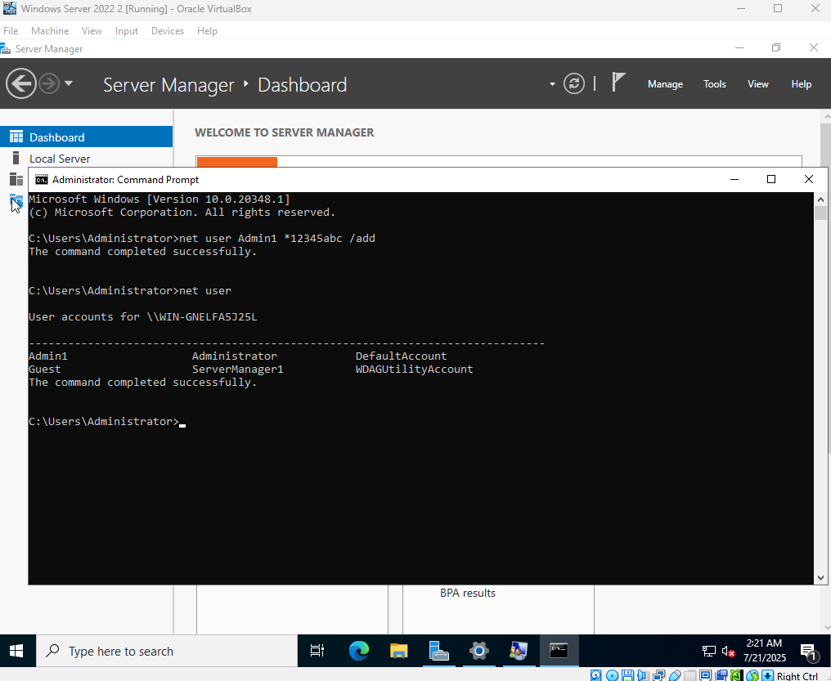
CLI user account

Slide 15
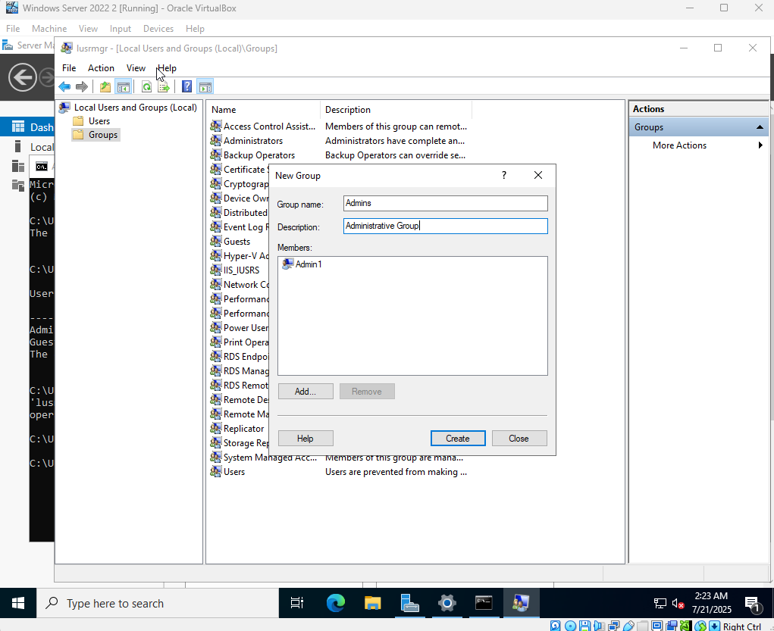

groups

Slide 16
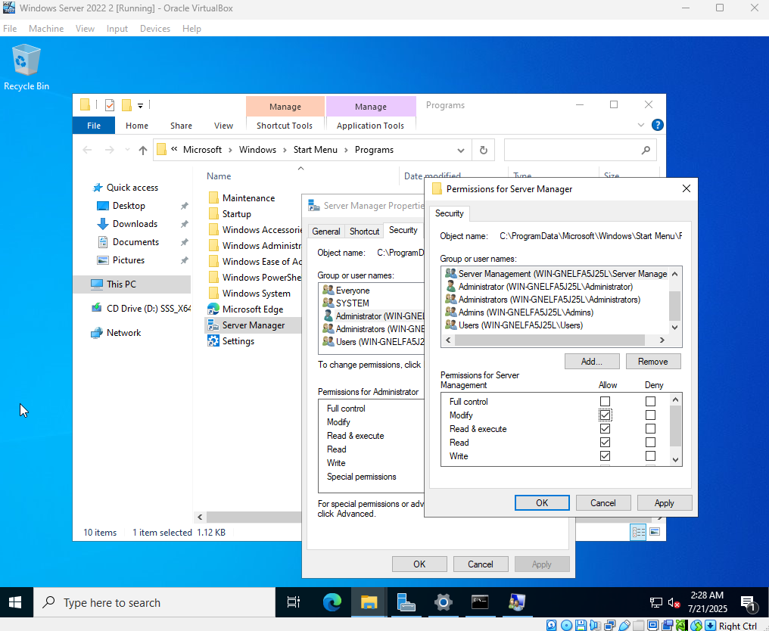
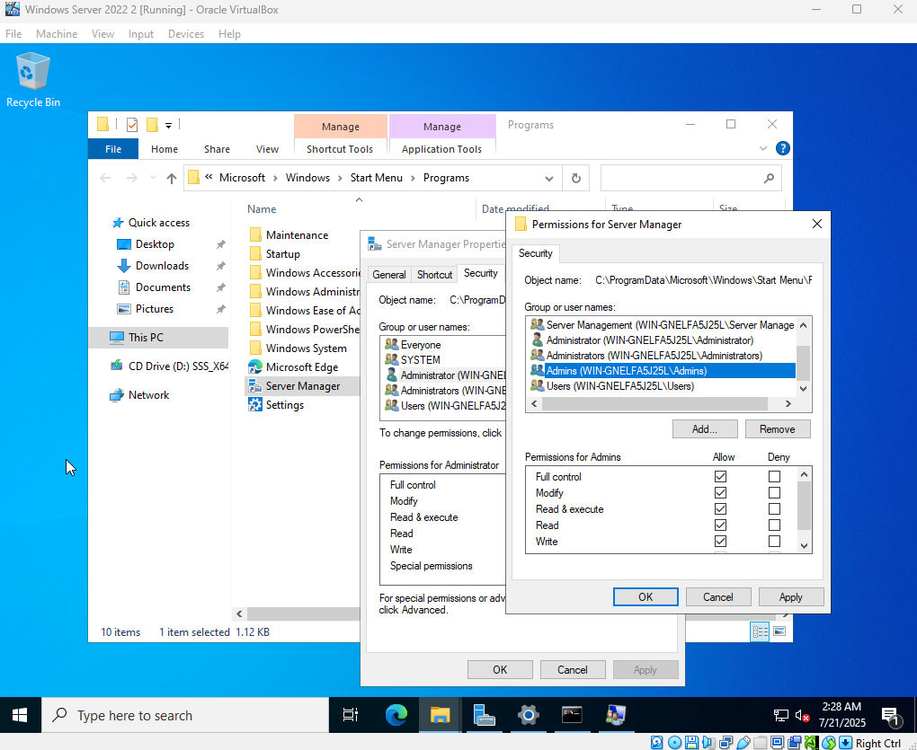

Slide 17
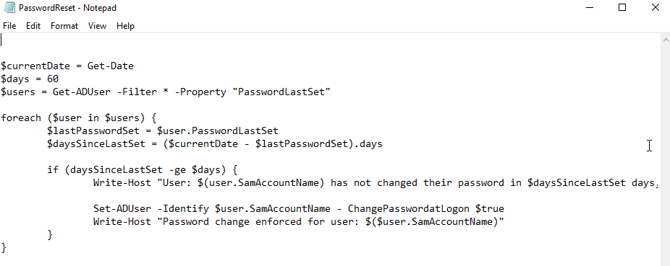
This script would check when each users last change their passwords using the foreach and if variables and compare it to the days figure of 60 (days) to force a password reset bimonthly if the lastPasswordSet amount is greater (-ge) than the days figure.
This script does not function correctly however in our study as our simulated systems are developed into a full organisational network therefore it is not joined into a domain

Slide 18
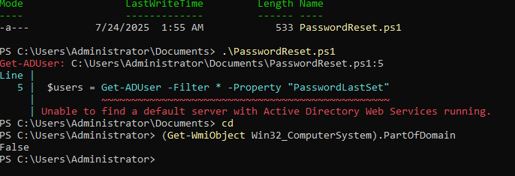
The error appearing is saying it cannot find a server and the –ADUser command doesn’t work without a domain controller
The command at the bottom of the figure responds with false meaning that it is not joined to a domain

